Slide 1
UNIVERSITY OF ENERGY AND NATURAL RESOURCES SUNYANI DEPARTMENT OF COMPUTER SCIENCE AND INFORMATICS BSc. COMPUTER SCIENCE
PROJECT TOPIC: Design and implementation of a web application for agricultural marketing (a case study of farmers within Bibiani Anhwiaso Bekwai (B.A.B). Municipal assembly)
By:
ASANTE RICHMOND AND SAGOE BRIGHT MARCUS
UEB3509819 UE20035117

Slide 2
Introduction
Agricultural marketing incorporates all exercises which adds value to agricultural products as they move from zones of agrarian generation to extreme consumption points
A successful and effective marketing framework guarantees fair returns to partners but unfortunately small consideration is paid to this segment in Bibiani-Anhwiaso-Bekwai (BAB) Municipality

Slide 3
Problem Statement
The farmers in the B.A.B Municipality are often cheated by middlemen who usually purchase their products at very affordable prices for resale at relatively high prices.
During the harvest, most of the products go waste because there is no ready market it.

Slide 4
Significance of the Study
It provides wide market for farm produce
It will help better the standard of living of the farmers
It provides an efficient means to purchase agricultural products
It prevents waste and increases productivity

Slide 5
Objectives(Specific)
Design and implement an online platform for farmers to showcase their products
Provide a mobile system that would enable customers order agricultural products online
Design and implement a real time mobile payment system

Slide 6
Methodology
Rapid Application Development Model (RAD)
It refers to a type of software development methodology that uses minimal planning in favour of rapid prototyping
In the RAD model, the functional modules are developed in parallel as prototypes and are integrated to make the complete product for faster product delivery.

Slide 7
Use-Case of the System

Slide 8
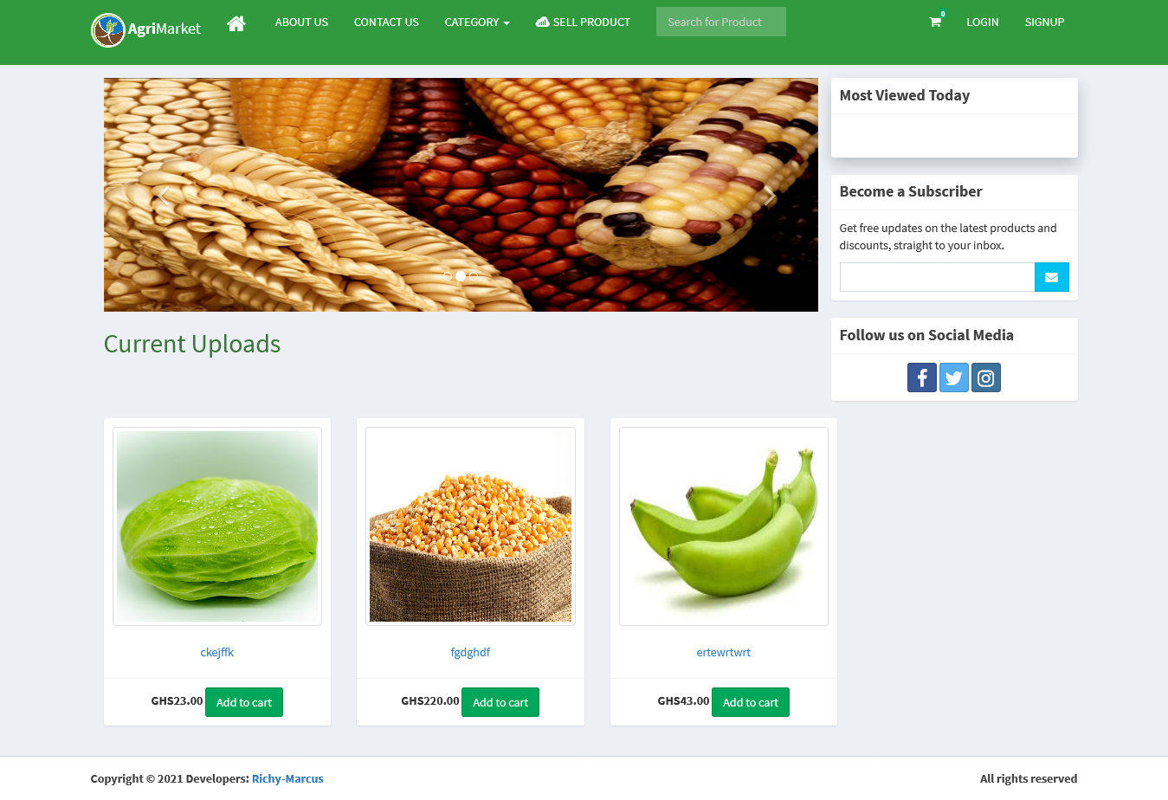
Results
Main page

Slide 9
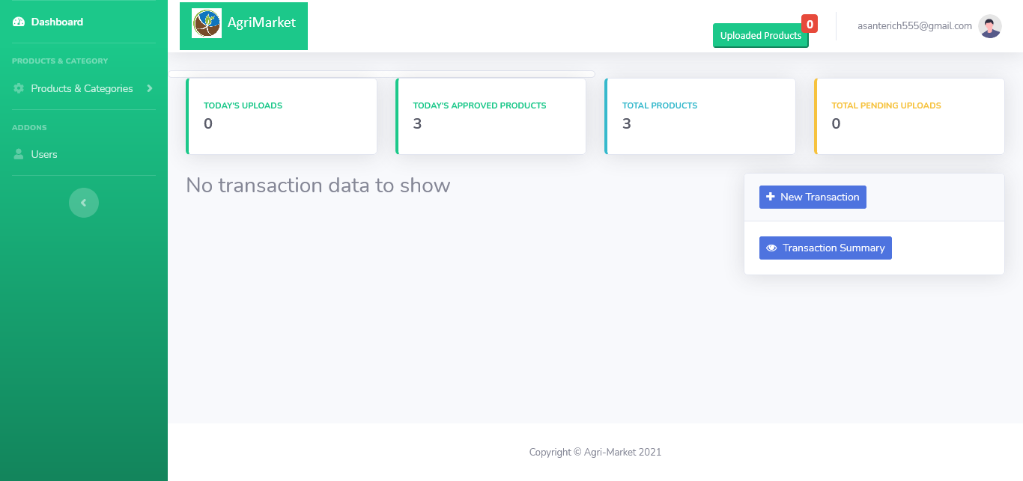
Results cont’d
Admin main page

Slide 10
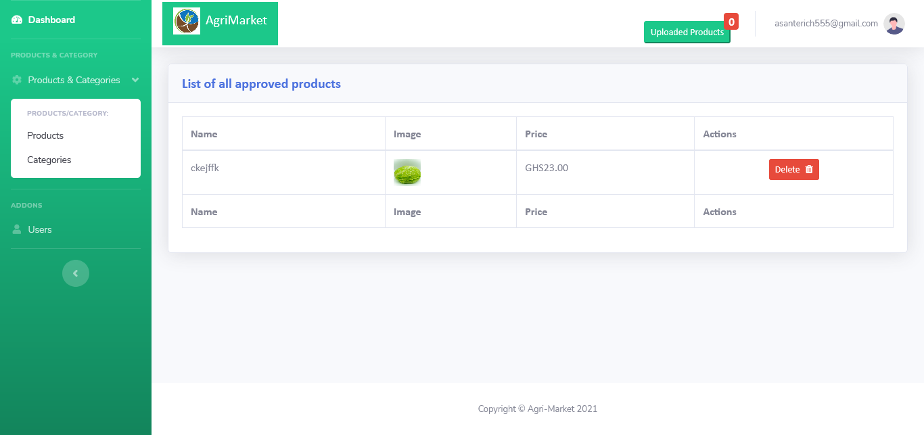
Results cont’d
Product page

Slide 11
Conclusion
The aim of this project is to provide an online marketing system to be used by farmers and buyers of agricultural products within BAB Municipality. The aims include, to automate marketing, purchasing and payment of agricultural products. This project has been successfully completed and will go a long way to change the mode of marketing and buying of the products of smallholder farmers in the Municipality.

Slide 12
Conclusion
The aim of this project is to provide an online marketing system to be used by farmers and buyers of agricultural products within BAB Municipality. The aims include, to automate marketing, purchasing and payment of agricultural products. This project has been successfully completed and will go a long way to change the mode of marketing and buying of the products of smallholder farmers in the Municipality.

Slide 13
References
Fred, M. D., & Patricia A. (2013) “Agricultural sector development: Policies and options”. University of Ghana
Abdul, G., Hammad, B., & Asif, M. (2010). “Marketing of Agricultural Products. Institute of Business Management Sciences, University of Agriculture, Faisalabad, Pakistan.
Clemens, B., Xinshen, D., Ramatu, A., & James, T. (2015). Agriculture for Development in Ghana: New Opportunities and Challenges, International Food Policy Research Institute
Ghana Statistical Service (2015). Labour force report.
Mamudu, A. A., Chris, J. G., & Peter, D. (2013). Improvement in Crop Production in Ghana: Is it due to Area Expansion or Increased Productivity? School of Agriculture, Policy and Development, University of Reading, Reading, RG6 6AR, United Kingdom
Nilesh, U.B. (2020). Digital agricultural marketing: step towards Sustainable agricultural sector. PIRENS Institute of Business Management and Administration, Savitribai Phule Pune University
Olga, N., & Julia, K. (2021) The role of digital marketing in improving the efficiency of the product distribution system of agricultural enterprises in the Krasnoyarsk Region, Krasnoyarsk. State Agrarian University, Krasnoyarsk, Russia

Slide 14
End of presentation
Thank You!

